Slide 1
Evaluation on Movie Classification on popular list from Rotten Tomatoes
Huang Yanzhen DC126732
Chen Zirui DC127901

Slide 2





1. Introduction
Rotten Tomatoes is a review-aggregation website for film and television in the U.S.
It has its own ranking system of movies, with three tiers: Certified Fresh, Fresh, and Rotten.
The project is going to evaluate on the classification among the fundamental scores behind its ranking system, that are:
Audience Sentiment (Binary, negative or positive)
Audience Score (Numeric, 0 to 100)
Critics Sentiment (Binary, negative or positive)
Critics Score (Numeric, 0 to 100)
The target of our classification is Critic Score.
Icon | Score | Description
 | 100–75% | Certified Fresh: Wide-release films with a score of 75% or higher that are reviewed by at least 80 critics, of whom 5 are “Top Critics”. The “Certified Fresh” seal remains until the score drops below 70%. Films with limited releases require only 40 reviews (including 5 from "Top Critics") to qualify for this seal. For TV shows, only individual seasons are eligible for consideration, and each must have at least 20 critic reviews.
 | 100–60% | Fresh: Films or TV shows with a score of 60% or higher that do not meet the requirements for the "Certified Fresh" seal.
 | 59–0% | Rotten: Films or TV shows with a score of 59% or lower receive this seal.

Slide 3
Project Process
Web
Crawler
Crawler
Crawl information from the rotten tomatoes’ website;
Crawls the top 100 + movies;
Evaluation
We develop the evaluation algorithm using python;
Uses entropy & information gain as the measurement of purity;
Conclusion
We then derives a sequence of dividing conditions based on its purity;
We may get extra information.
Excel Data
Evaluation
Information Gains
Conclusion

Slide 4
2. Crawler Part
Web
Crawler
Excel Data
Evaluation
Information Gains
Conclusion

Slide 5
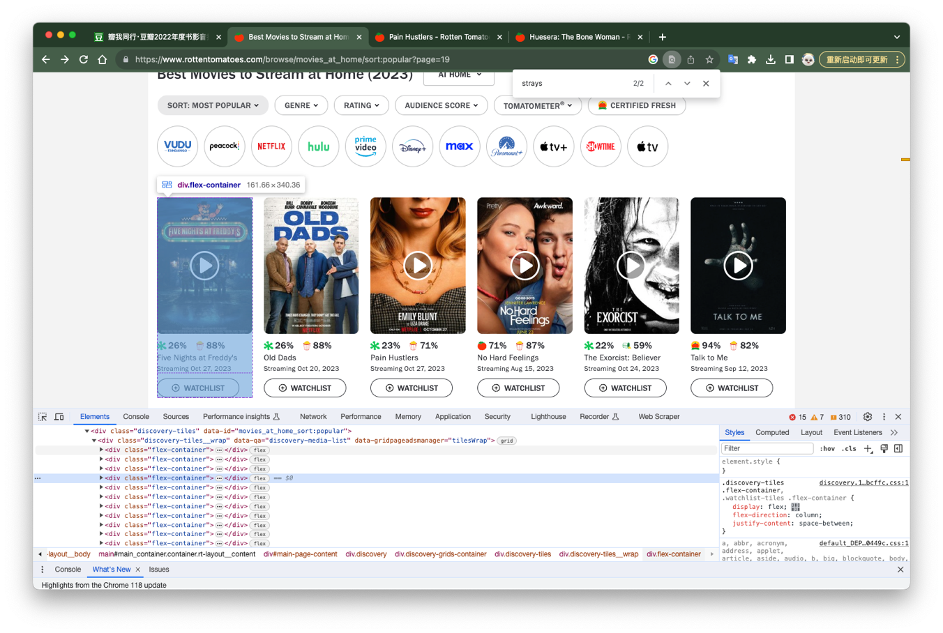
2. Crawler Part
2.1 Analyze the page structure
The collection of movie items is represented by a grid view of <div> container.
What to do:
Find all of <div> whose class is “flex-container”;
Store all the <div> object in a iterable list;
For each object, extract intended data;
The following part would focus on a specific iteration.

Slide 6
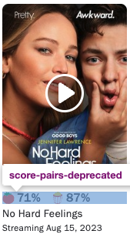
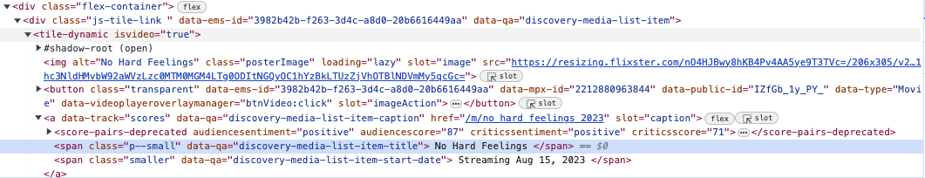
2. Crawler Part
2.1.1 Movie Title and Stream Time
Movie Title
Stored in the <span> tag with class “p-small”.
Since <span> was under the <div> movie item, we easily extract it by xpath.
Problems:
The title we obtain in fact has some spaces and enters, so we eliminate them using regular expression.
Meanwhile, we get some false elements. Hence, we filter out those elements whose title is none type.
__get_movies__.py
movie_title = score_container.xpath(".//span[@class='p--small']/text()").get() # Guardian method. Don't get useless message if movie_title is None: continue movie_title = re.sub(r"\n|\s","", movie_title)

Slide 7
2. Crawler Part
2.1.1 Movie Title and Stream Time
Stream Time
Stored in <span> with class “smaller”
Problems:
We don’t want the “Streaming” string, remove it with regular expression.
Movie Title and Stream Time helps us to identify whether there are identical information.
__get_movies__.py
# Stream time stream_time = score_container.xpath(".//span[@class='smaller']/text()").get() stream_time = re.sub(r"\n|\s|Streaming", "", stream_time)

Slide 8
2. Crawler Part
2.1.2 Scores & Sentiments
The four measurements lies in the <score-pairs-depricated> tag.
This tag represents the score pair bar UI on the card view of a movie.
The four items within the tag is our required data:
Audience Sentiment
Audience Score
Critics Sentiment
Critics Score
We first extract <score-pairs-deprecated> as root, then extract its items one by one.
__get_movies__.py
# Overall score container evaluation_scores = score_container.xpath(".//score-pairs-deprecated") # Four important scores aud_sentiment = evaluation_scores.xpath("@audiencesentiment").get() aud_score = evaluation_scores.xpath("@audiencescore").get() critics_sentiment = evaluation_scores.xpath("@criticssentiment").get() critics_score = evaluation_scores.xpath("@criticsscore").get()

Slide 9
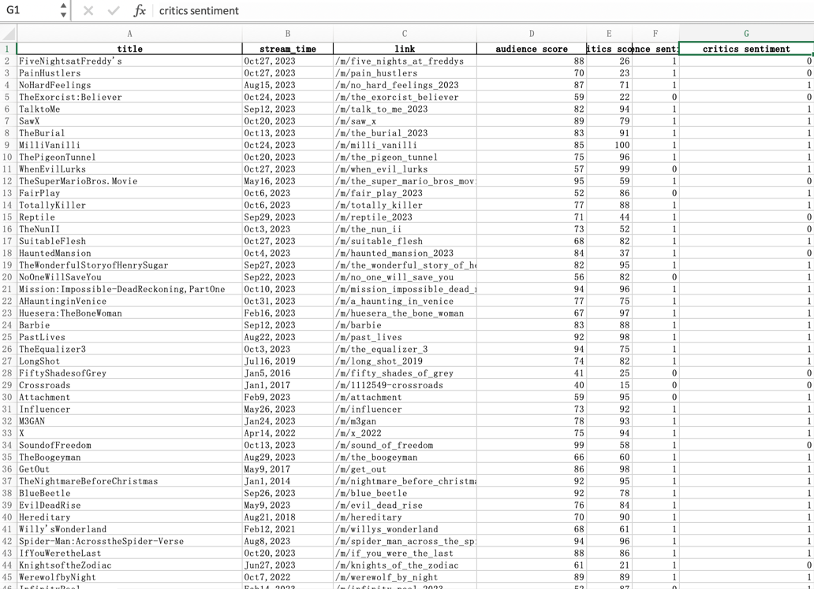
2. Crawler Part
__get_movies__.py
# Processing data # Change negative/positive to binary expressions, which is a lot easier to cope with bin_aud_sentiment = 0 if aud_sentiment == 'negative' else 1 bin_critics_sentiment = 0 if critics_sentiment == 'negative' else 1 data = { "title": movie_title, "stream_time": stream_time, 'link': score_link, "audience score": aud_score, "critics score": critics_score, "audience sentiment": bin_aud_sentiment, "critics sentiment": bin_critics_sentiment, } # Store the data in a new Excel file self.start_urls.append("https://www.rottentomatoes.com/" + data['link']) if self.custom_settings['SAVE_DATA']: __save_data__.save_data_to_excel(data)
2.2 Store the extracted data into an Excel file
At the first iteration, the crawler process creates an excel file;
For each iteration, it stores a row of the four data into the excel file;
__save_data__.py is another program we wrote to peform the data storage algorithm.
Extracted Excel file:

Slide 10
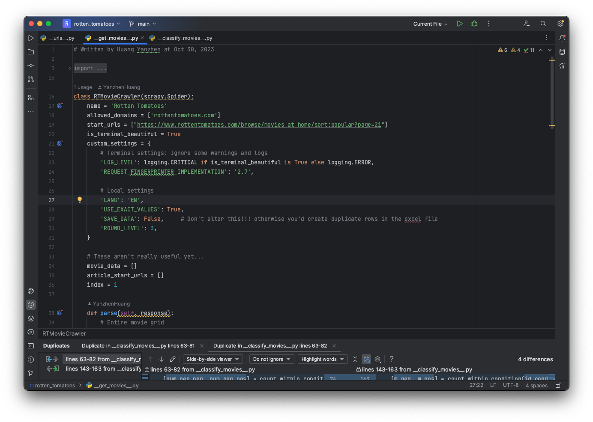
2. Crawler Part
2.3 Code Overview

Slide 11
__get_movies__.py
class RTMovieCrawler(scrapy.Spider): name = 'Rotten Tomatoes' allowed_domains = ['rottentomatoes.com'] start_urls = ["https://www.rottentomatoes.com/browse/movies_at_home/sort:popular?page=21"] is_terminal_beautiful = True custom_settings = { # Terminal settings: Ignore some warnings and logs 'LOG_LEVEL': logging.CRITICAL if is_terminal_beautiful is True else logging.ERROR, 'REQUEST_FINGERPRINTER_IMPLEMENTATION': '2.7', # Local settings 'LANG': 'EN', 'USE_EXACT_VALUES': True, 'SAVE_DATA': False, # Don't alter 'ROUND_LEVEL': 3, } # These aren't really useful yet... movie_data = [] article_start_urls = [] index = 1 def parse(self, response): # Entire movie grid movie_list = response.xpath("//div[@class='flex-container']") for movie in movie_list: # Father element: Overall container score_container = movie.xpath(".//a[@data-track='scores']") score_link = score_container.xpath("@href").get() # Title movie_title = score_container.xpath(".//span[@class='p--small']/text()").get() # Guardian method. Don't get useless message if movie_title is None: continue movie_title = re.sub(r"\n|\s","", movie_title) # In fact the movie title from rt is kinda sussy # Stream time stream_time = score_container.xpath(".//span[@class='smaller']/text()").get() stream_time = re.sub(r"\n|\s|Streaming", "", stream_time) # Overall score container evaluation_scores = score_container.xpath(".//score-pairs-deprecated") # Four important scores aud_sentiment = evaluation_scores.xpath("@audiencesentiment").get() aud_score = evaluation_scores.xpath("@audiencescore").get() critics_sentiment = evaluation_scores.xpath("@criticssentiment").get() critics_score = evaluation_scores.xpath("@criticsscore").get()
__get_movies__.py
# Processing data # Change negative/positive to binary expressions, which is a lot easier to cope with bin_aud_sentiment = 0 if aud_sentiment == 'negative' else 1 bin_critics_sentiment = 0 if critics_sentiment == 'negative' else 1 data = { "title": movie_title, "stream_time": stream_time, 'link': score_link, "audience score": aud_score, "critics score": critics_score, "audience sentiment": bin_aud_sentiment, "critics sentiment": bin_critics_sentiment, } # Append movie data... not self.movie_data.append(data) # Store the data in a new Excel file self.start_urls.append("https://www.rottentomatoes.com/" + data['link']) if self.custom_settings['SAVE_DATA']: __save_data__.save_data_to_excel(data) # Print beautiful data in console :) print("--------------------") print( str(self.index) + '\n' + "title: " + movie_title + '\n' + "stream time: " + stream_time + '\n' + "link:" + score_link + '\n' + "audience sentiment: " + aud_sentiment + '\n' + "audience score: " + aud_score + '\n' + "critics sentiment: " + critics_sentiment + '\n' + "critics score: " + critics_score ) # This thread is async so I have to do this to omit race conditions self.index += 1 def run_process(): process = CrawlerProcess() process.crawl(RTMovieCrawler) process.start() run_process()
Encapsulate data into a dictionary
Save data into excel
Get a list of movie item
Get four attributes

Slide 12
3. Evaluation Algorithms
Web
Crawler
Excel Data
Evaluation
Information Gains
Conclusion

Slide 13
3. Evaluation Algorithms
First 10 rows of data:
title | audience score | critics score | audience sentiment | critics sentiment
FiveNightsatFreddy's | 88 | 26 | 1 | 0
PainHustlers | 70 | 23 | 1 | 0
NoHardFeelings | 87 | 71 | 1 | 1
TheExorcist:Believer | 59 | 22 | 0 | 0
TalktoMe | 82 | 94 | 1 | 1
SawX | 89 | 79 | 1 | 1
TheBurial | 83 | 91 | 1 | 1
MilliVanilli | 85 | 100 | 1 | 1
ThePigeonTunnel | 75 | 96 | 1 | 1
WhenEvilLurks | 57 | 99 | 0 | 1
… | … | … | … | …
Due to large amount of data:
Develop an algorithm to calculate entropy rather than manually.
Use:
Audience Score,
Critics Score,
Audience Sentiment
to classify into:
Critics Sentiment.

Slide 14
3. Evaluation Algorithms
Example:
title | audience score | critics score | audience sentiment | critics sentiment
FiveNightsatFreddy's | 88 | 26 | 1 | 0
PainHustlers | 70 | 23 | 1 | 0
NoHardFeelings | 87 | 71 | 1 | 1
TheExorcist:Believer | 59 | 22 | 0 | 0
TalktoMe | 82 | 94 | 1 | 1
SawX | 89 | 79 | 1 | 1
TheBurial | 83 | 91 | 1 | 1
MilliVanilli | 85 | 100 | 1 | 1
ThePigeonTunnel | 75 | 96 | 1 | 1
WhenEvilLurks | 57 | 99 | 0 | 1
… | … | … | … | …
3.1.1 count_within_condition()
Input: rows with same condition node
Count: numnber of rows where
critics_sentiment = negative
critics_sentiment = positive
Often used, therefore encapsulate it.
input: index of rows where audience_sentiment = 1
output:
number of target negative = 2
number of target positive = 6
__classify_movies__.py
# Count positive and negative samples within a conditional class def count_within_condition(cond_class, target): sample_neg = 0 sample_pos = 0 for target_index in cond_class: if target[target_index] == 0: sample_neg += 1 elif target[target_index] == 1: sample_pos += 1 return sample_neg, sample_pos
Notes:
First, we need to define some utility functions.

Slide 15
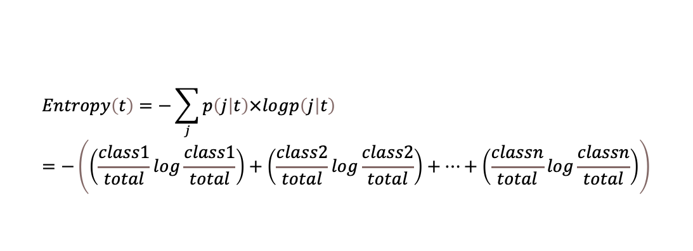
3. Evaluation Algorithms
Entropy of a node:
$$Entropy\left(t\right)=−\sum_{j}{p\left(j | t\right)×logp\left(j | t\right)}=−\left(\left(\frac{class1}{total}log\frac{class1}{total}\right)+\left(\frac{class2}{total}log\frac{class2}{total}\right)+…+\left(\frac{classn}{total}log\frac{classn}{total}\right)\right)$$
3.1.2 get_entropy()
Since the evaluation process involves abundant calculations of entropy, a generic get_entropy() function is needed.
We have only two target classes:
critics_sentiment = negative or
critics_sentiment = positive
Therefore, the get_entropy() function can take only two inputs.
Debug:
Python may raise an error when the log10() function has an input of 0. Therefore a guardian condition is needed.
__classify_movies__.py
# Processing data def get_entropy(a, b): total = a + b a_ratio = a / total b_ratio = b / total # Deal with divide by 0 problem a_log_a = a_ratio * math.log10(a_ratio) if a_ratio != 0 else 0 b_log_b = b_ratio * math.log10(b_ratio) if b_ratio != 0 else 0 # Finally, calculate the entropy..... entropy = (-1) * (a_log_a + b_log_b) return entropy
Guardian method to prevent math error

Slide 16
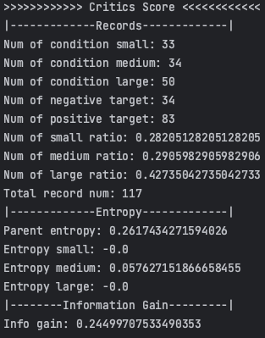
3. Evaluation Algorithms
data
data = { "Name": cond_name, "Records": { "Num of condition small": num_cond_small, "Num of condition medium": num_cond_medium, "Num of condition large": num_cond_large, "Num of negative target": num_targ_neg, "Num of positive target": num_targ_pos, "Num of small ratio": cond_small_ratio, "Num of medium ratio": cond_medium_ratio, "Num of large ratio": cond_large_ratio, "Total record num": num_total, }, "Entropy": { "Parent entropy": e_parent, "Entropy small": e_small, "Entropy medium": e_medium, "Entropy large": e_large }, "Information Gain": { "Info gain": info_gain, } }
3.1.3 console_log()
To make sure the algorithm works fine, we yield plenty amount of data;
console_log() helps to print these data in a neat way.
__classify_movies__.py
def console_log(data, indent=0): # Treat "Name" tage specially condition_name = data.get("Name") if condition_name is not None: print("\n\n>>>>>>>>>>>> " + condition_name + " <<<<<<<<<<<<") del data['Name'] # Traverse all the data items. for key, val in data.items(): # Dictionary type, parse section if isinstance(val, dict): # Trick: make header constant length # As data go deeper, the length of title is shorter hyphen_num = 45 - 10 * indent left_hyphens = (hyphen_num - len(key)) // 2 right_hyphens = hyphen_num - len(key) - left_hyphens title = "|-" + "-" * left_hyphens + key + "-" * right_hyphens + "-|" # Section title print(title) console_log(val, indent+1) else: # Section contents print(key + ": " + str(val))

Slide 17
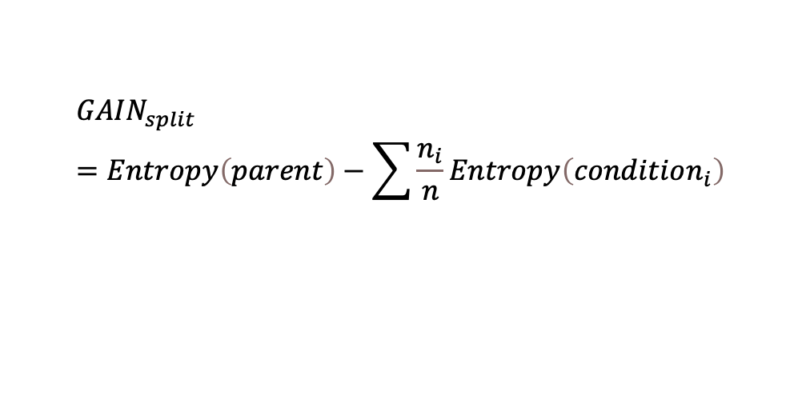
3. Evaluation Algorithms
First, seperate every 0s and 1s in the classification condition.
Audience Sentiment
19
98
negative
positive
__classify_movies__.py
# Categorize into 2 conditions: negative and positive id_cond_neg = [] # index of negative conditions id_cond_pos = [] # index of positive conditions for index, row in enumerate(condition): if row == 0: id_cond_neg.append(index) elif row == 1: id_cond_pos.append(index) else: raise ValueError("Invalid binary value!")
3.2 binary_analysis()
Analyze the classification using binary conditions.
Here, audience_sentiment is our only binary condition.
Generally, this function:
Compute emtropy for each children and parent;
and output the Information Gain of the split.
The larger the info gain is, the purer the classification.
Second, count number of each class for every condition situations.
__classify_movies__.py
# Negative and positive part for each conditions [num_neg_neg, num_neg_pos] = count_within_condition(id_cond_neg, target) [num_pos_neg, num_pos_pos] = count_within_condition(id_cond_pos, target)
Lastly, compute Entropy for parent and all children. Compute Information Gain from the seperation.
$${GAIN}_{split}=Entropy\left(parent\right)−\sum{\frac{n_{i}}{n}}Entropy\left(condition_{i}\right)$$

Slide 18

3. Evaluation Algorithms
Lastly, compute Entropy for parent and all children. Compute Information Gain from the seperation.
$${GAIN}_{split}=Entropy\left(parent\right)−\sum{\frac{n_{i}}{n}}Entropy\left(condition_{i}\right)$$
__classify_movies__.py
# Compute entropy # Compute number of target neg & pos num_targ_neg = 0 num_targ_pos = 0 for target_value in target: if target_value == 0: num_targ_neg += 1 else: num_targ_pos += 1 # Parent entropy num_total = num_targ_neg + num_targ_pos # Total num of records e_parent = get_entropy(num_targ_neg, num_targ_pos) # Child entropy # Number of instances in each condition num_cond_neg = len(id_cond_neg) num_cond_pos = len(id_cond_pos) # Weights of each condition cond_neg_ratio = num_cond_neg / num_total if num_total != 0 else 0 # Target negative cond_pos_ratio = num_cond_pos / num_total if num_total != 0 else 0 # Target positive # Entropy of each condition e_neg = get_entropy(num_neg_neg, num_neg_pos) # Condition negative e_pos = get_entropy(num_pos_neg, num_pos_pos) # Condition positive # Information gain info_gain = e_parent - ( cond_neg_ratio * e_neg + cond_pos_ratio * e_pos )
3.2 binary_analysis()
Analyze the classification using binary conditions.
Here, audience_sentiment is our only binary condition.
Generally, this function:
Compute emtropy for each children and parent;
and output the Information Gain of the split.
The larger the info gain is, the purer the classification.

Slide 19
3. Evaluation Algorithms
Binary split using mean:
Audience Score
<mean
>mean
<mean
>mean
Three splits:
3.3 numeric_analysis()
Analyse using numeric conditions.
Audience Score
Critics Score
Test three splitting methods:
Binary Split using mean
Three Splits
Binary Split using normal distribution
Compare them and find the method with best info gain.
Audience Score
32
36
49
small
medium
large
Binary Split using normal distribution:
Audience Score
<mean
>mean
< T
>T

Slide 20
3. Evaluation Algorithms
Binary split using mean:
Audience Score
<mean
>mean
<mean
>mean
__classify_movies__.py
# Categorizing # Categorize into two conditions: small and large id_cond_left = [] id_cond_right = [] # Categorize into 3 conditions: small, medium, and large id_cond_small = [] # condition small id_cond_medium = [] # condition medium id_cond_large = [] # condition large for index, row in enumerate(condition): # Divide by mean if row < mean_val: id_cond_left.append(index) else: id_cond_right.append(index) # Divide by normal distribution if row < left_thresh: id_cond_small.append(index) elif row > right_thresh: id_cond_large.append(index) else: id_cond_medium.append(index)
3.3 numeric_analysis()
Analyse using numeric conditions.
Audience Score
Critics Score
Binary Split using Mean:
Sperate data into two sets, one smaller than mean and one larger

Slide 21
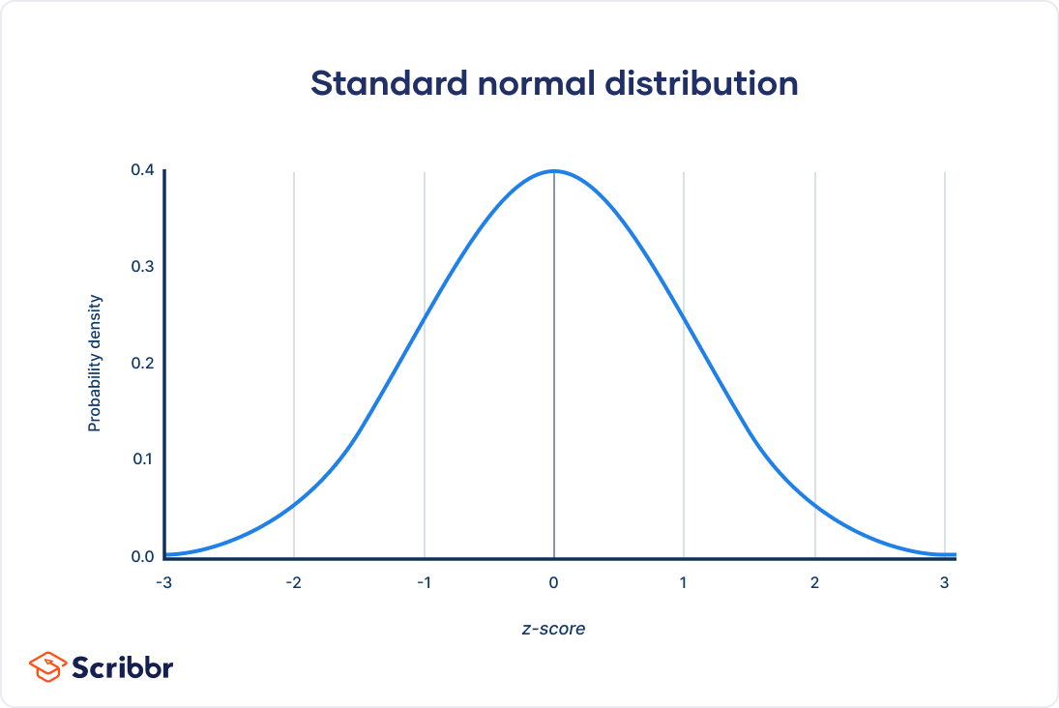
3. Evaluation Algorithms
y = P(Audience Score == x)
Small
Medium
Large
T1
T2
mean
Audience Score
degree*sample variance
3.3 numeric_analysis()
Analyse using numeric conditions.
Audience Score
Critics Score
Three splits: Seperate numeric conditions into three nodes using two thresholds T1 and T2:
Small: value < T1;
Medium: value between T1 and T2;
Large: value > T2.
Use normal distribution (Central Limit Theorem).
Using Normal Distribution helps to split values in a relative equal manner. The degree is dynamic, helping us to obtain an optimized information gain for a split.
For example, the optimized degree for splitting audience_score is 0.4. i.e. the degree of 0.4 makes the info gain of audience_score the largest.
__classify_movies__.py
# Defines left mean and right mean mean_val = condition.mean() if method == "normal_dist": # Normal distribution left_thresh = mean_val - degree * condition.std() right_thresh = mean_val + degree * condition.std() else: left_thresh = (condition.min() + mean_val) / 2 right_thresh = (condition.max() + mean_val) / 2

Slide 22
3. Evaluation Algorithms
Split condition into 3 nodes:
Audience Score
32
36
49
small
medium
large
Critics Sentiment - : 12
Critics Sentiment +: 20
Critics Sentiment - : 36
Critics Sentiment +: 0
Critics Sentiment - : 18
Critics Sentiment +: 31
__classify_movies__.py
# Categorizing # Categorize into two conditions: small and large id_cond_left = [] id_cond_right = [] # Categorize into 3 conditions: small, medium, and large id_cond_small = [] # condition small id_cond_medium = [] # condition medium id_cond_large = [] # condition large for index, row in enumerate(condition): # Divide by mean if row < mean_val: id_cond_left.append(index) else: id_cond_right.append(index) # Divide by normal distribution if row < left_thresh: id_cond_small.append(index) elif row > right_thresh: id_cond_large.append(index) else: id_cond_medium.append(index)
3.3 numeric_analysis()
Analyse using numeric conditions.
Three splits: Seperate numeric conditions into three nodes using two thresholds T1 and T2:
Small: value < T1;
Medium: value between T1 and T2;
Large: value > T2.
Use normal distribution (Central Limit Theorem).

Slide 23
3. Evaluation Algorithms
Split condition into 3 nodes:
Audience Score
32
49
36
small
medium
large
Critics Sentiment - : 12
Critics Sentiment +: 20
Critics Sentiment - : 36
Critics Sentiment +: 0
Critics Sentiment - : 18
Critics Sentiment +: 31
__classify_movies__.py
# Statistics within categorizing # Negative and positive part of each conditions # Single node: Two divisions [lf_neg, lf_pos] = count_within_condition(id_cond_left, target) [rt_neg, rt_pos] = count_within_condition(id_cond_right, target) # Single node: Three divisions [s_neg, s_pos] = count_within_condition(id_cond_small, target) [m_neg, m_pos] = count_within_condition(id_cond_medium, target) [l_neg, l_pos] = count_within_condition(id_cond_large, target) # Combined node [sm_neg, sm_pos] = [s_neg + m_neg, s_pos + m_pos] [ml_neg, ml_pos] = [m_neg + l_neg, m_pos + l_pos]
3.3 numeric_analysis()
Analyse using numeric conditions.
Three splits: Seperate numeric conditions into three nodes using two thresholds T1 and T2:
Small: value < T1;
Medium: value between T1 and T2;
Large: value > T2.
Use normal distribution (Central Limit Theorem).

Slide 24
3. Evaluation Algorithms
Split condition into 3 nodes:
Audience Score
32
49
36
small
medium
large
Critics Sentiment - : 12
Critics Sentiment +: 20
Critics Sentiment - : 36
Critics Sentiment +: 0
Critics Sentiment - : 18
Critics Sentiment +: 31
__classify_movies__.py
# Statistics within categorizing # Negative and positive part of each conditions # Single node: Two divisions [lf_neg, lf_pos] = count_within_condition(id_cond_left, target) [rt_neg, rt_pos] = count_within_condition(id_cond_right, target) # Single node: Three divisions [s_neg, s_pos] = count_within_condition(id_cond_small, target) [m_neg, m_pos] = count_within_condition(id_cond_medium, target) [l_neg, l_pos] = count_within_condition(id_cond_large, target) # Combined node [sm_neg, sm_pos] = [s_neg + m_neg, s_pos + m_pos] [ml_neg, ml_pos] = [m_neg + l_neg, m_pos + l_pos]
3.3 numeric_analysis()
Analyse using numeric conditions.
Binary split using normal distribution:
Combine either small & medium or medium & large of the three splits method.

Slide 25
3. Evaluation Algorithms
Combine two binary_analysis() and numeric_analysis() into a unified interface:
__classify_movies__.py
# Hybrid analysis, combining numeric and binary analysis. def hybrid_analysis(condition, target, is_binary=True, cond_name="Analysis Name", method="normal_dist", degree=0.4): if is_binary: info_gain = binary_analysis(condition, target, cond_name) else: info_gain = numeric_analysis(condition, target, cond_name, method, degree) return info_gain
Extract Data:
First, read the Excel table generated by the crawler.
3.4 Rank Info Gain
By ranking the information gain of all conditions, we would obtain the classifying sequence.
__classify_movies__.py
# Read Excel file and do analysis filepath = './movie_list/movie_data.xlsx' movie_data = pd.read_excel(filepath)
Then, extract condition columns and target column.
title | audience score | critics score | audience sentiment | critics sentiment
FiveNightsatFreddy's | 88 | 26 | 1 | 0
PainHustlers | 70 | 23 | 1 | 0
NoHardFeelings | 87 | 71 | 1 | 1
TheExorcist:Believer | 59 | 22 | 0 | 0
TalktoMe | 82 | 94 | 1 | 1
SawX | 89 | 79 | 1 | 1
… | … | … | … | …
__classify_movies__.py
# Conditions aud_score = movie_data['audience score'] critics_score = movie_data['critics score'] aud_sentiment = movie_data['audience sentiment'] # Target critics_sentiment = movie_data['critics sentiment']

Slide 26
3. Evaluation Algorithms
By calling the hybrid_analysis() function, taking the three conditions and targetas inputs, we get a list of information gain.
__classify_movies__.py
# Get info gain from the three conditions ig_aud_sentiment = hybrid_analysis( aud_sentiment, critics_sentiment, True, "Audience Sentiment" ) # Audience sentiment ig_aud_score = hybrid_analysis( aud_score, critics_sentiment, False, "Audience Score", degree=0.4 ) # Audience score ig_critics_score = hybrid_analysis( critics_score, critics_sentiment, False, "Critics Score", degree=0.5 ) # Critics score
3.4 Rank Info Gain
By ranking the information gain of all conditions, we would obtain the classifying sequence.

Slide 27
4. Conclusion
Web
Crawler
Excel Data
Evaluation
Information Gains
Conclusion

Slide 28
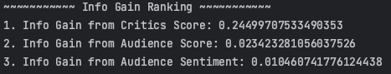
4. Conclusion
Total Ranking:

Slide 29
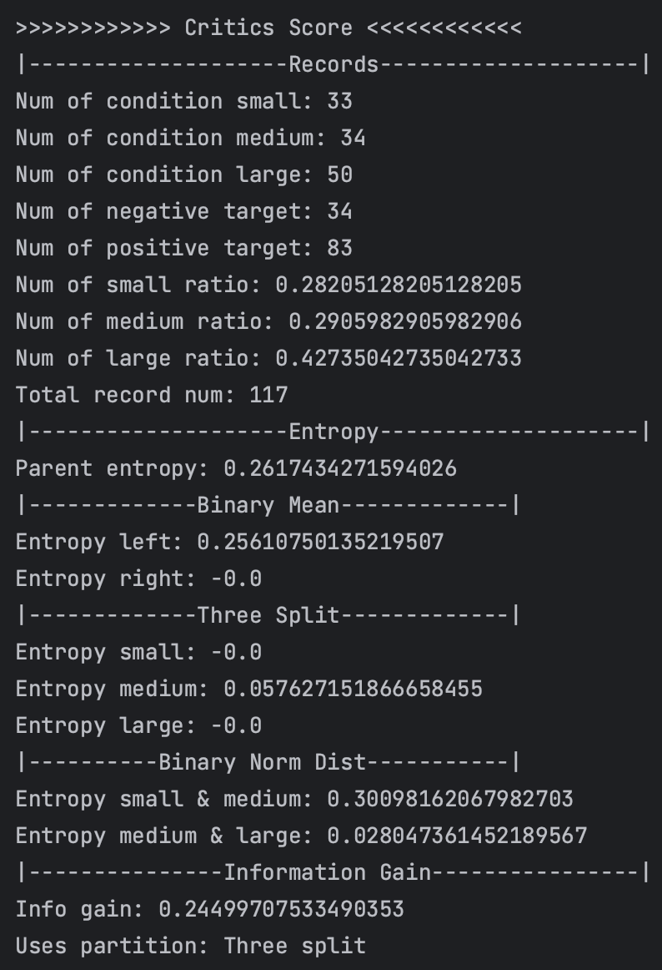
4. Conclusion
4.1 Critics Score
Critic Score is the purest. By inspecting the detailed data, we can see that the entropy of small and large part is zero, meaning that it is well-classified in the two parts. In deed, the information gain of entropy is the highest.

Slide 30
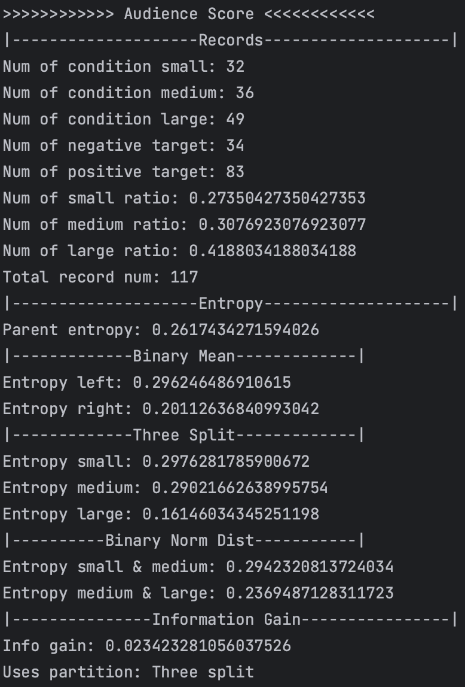
4. Conclusion
4.2 Audience Score
Audience Score is the second purest. However, it is still significantly smaller than the information gain from the Critics Score. We can see that the dividing condition of small and medium is roughly the same, while the entropy of large section is significantly lower (around 0.16 compared to around 0.29). This means that the large section has a better classification than the other two.

Slide 31
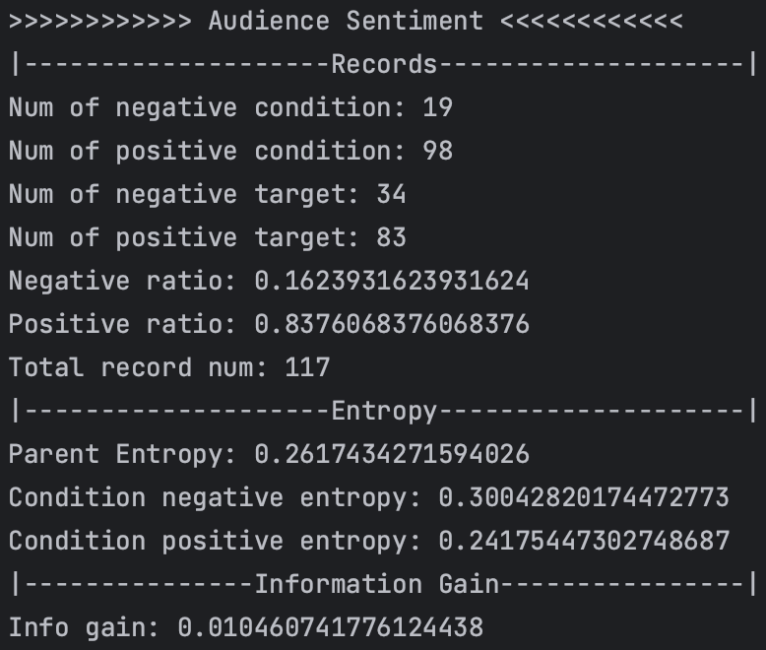
4. Conclusion
4.2 Audience Sentiment
Audience Sentiment has the lowest purity, yet it’s at the same metering level of Audience Score. The two condition situations (negative and positive) both has quite high an entropy, meaning the dividing is indeed not very ideal. This indicates that the audience sentiment doesn’t quite match with the critics one.

Slide 32
Thank You!

Slide 33
Draft
All Instances
19
98
audience_sentiment = 0
audience_sentiment = 1
Don’t delete it, but don’t use it either.
10
9
47
51
critics_sentiment
= negative
critics_sentiment
= positive
critics_sentiment
= negative
critics_sentiment
= positive

